Slide 1
Lesson 14 Context Free Grammars (CFG) and Context Free Languages (CFL)

Slide 2
We recall that a regular grammar has the form:
A → aA|a|ϵ
A regular grammar generates a regular language.
Regular languages can be accepted by finite acceptors.
Regular language can be denoted by regular expressions.

Slide 3
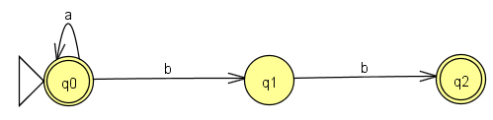
Example
G: A → aA|bB|ϵ
B → b
L(G) = a* + bb = E // expression
A finite automata M s.t. L(M) = L(E)

Slide 4
CFG’s and CFL’s
Context Free Grammar
Every rule has the form :
N → (N + T)*

Slide 5
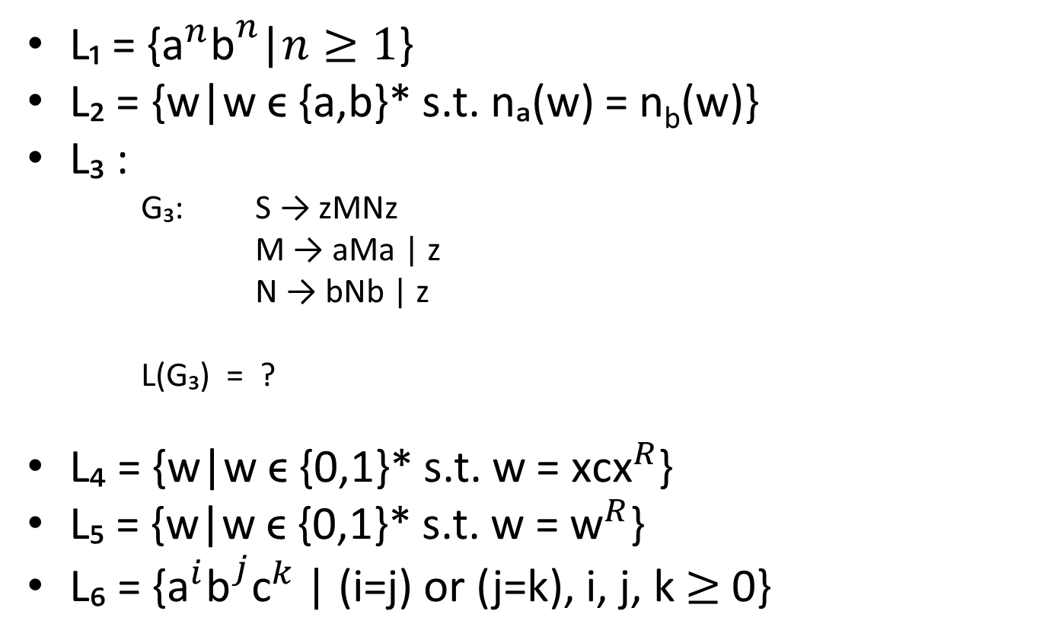
Examples

Slide 6
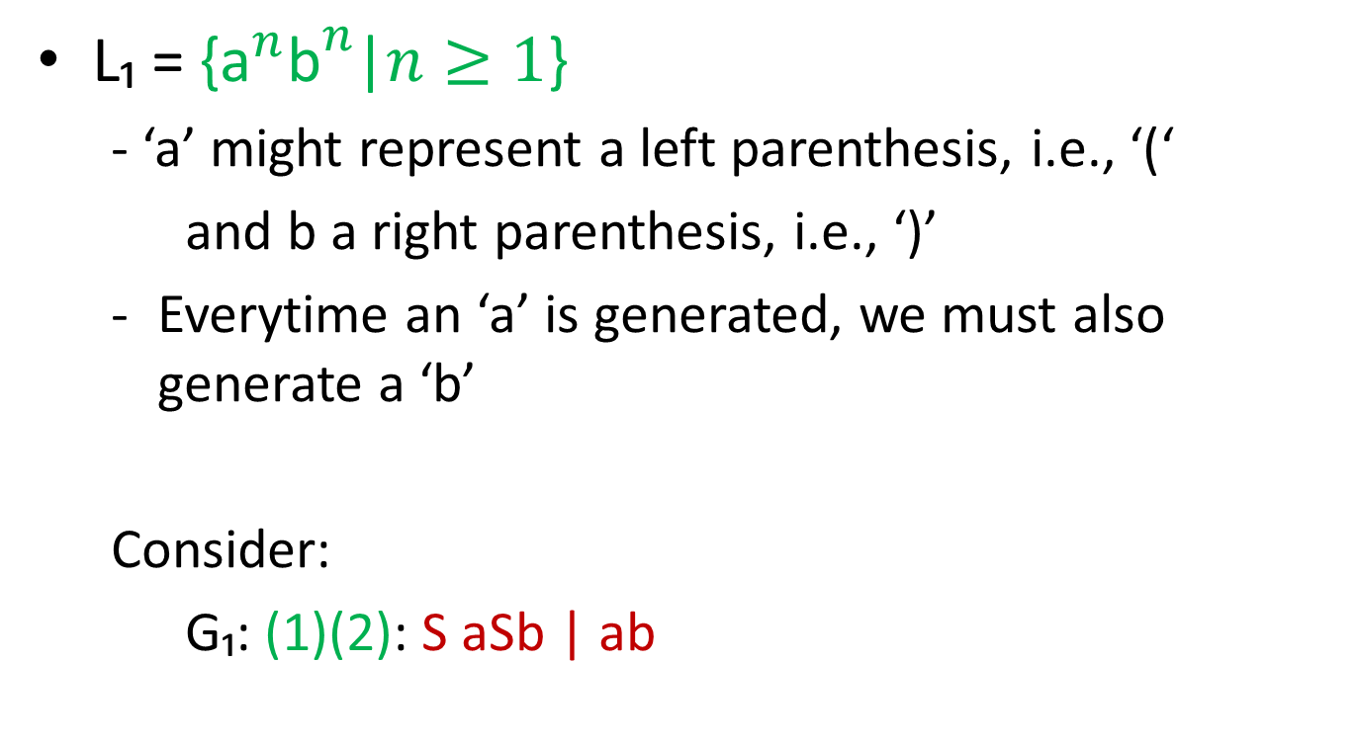
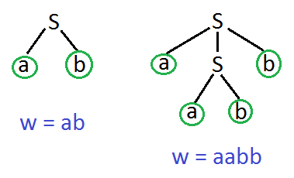
CFG’s and CFL’s

Slide 7
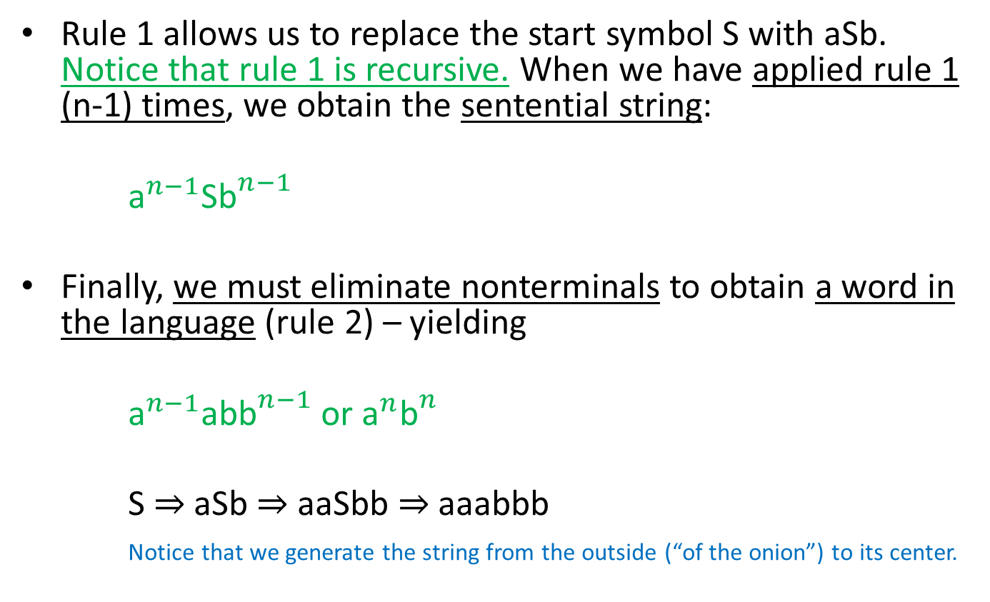
CFG’s and CFL’s

Slide 8
Context Free Languages
L₂ = {w|w ϵ {a,b}* s.t. na(w) = nb(w)}
Similar to L₁, everytime we generate an ‘a’ we must also generate a ‘b’. However, now order does not matter.
We consider:
G₂: (1)…(4) S → aSb | bSa | SS | ϵ
Let w₁ = ab S ⇒ aSb ⇒ ab
w₂ = ba S ⇒ bSa ⇒ ba
w₃ = abba S ⇒ SS ⇒ aSbS ⇒ aSbbSa ⇒ abbSa ⇒ abba
w₄ = babbaa S ⇒ bSa ⇒ bSSa ⇒ baSbSa ⇒ baSbbSaa ⇒ babbSaa ⇒ babbaa
In each instance, a leftmost derivation was used.
Notes:
Marked for Correction: Sub-scripts a and b n_a, and n_b

Slide 9
Context Free Languages
In our next example, we are given a grammar and must discover what language it generates.
G₃: (1) S → zMNz
(2)(3) M → aMa | z
(4)(5) N → bNb | z
i.e. What is L(G)?
From rule 1 we know that every string in L₃ begins and ends with a single Z.
S ⇒ zMNz
M: we use rules 2 and 3
N: we use rules 4 and 5

Slide 10
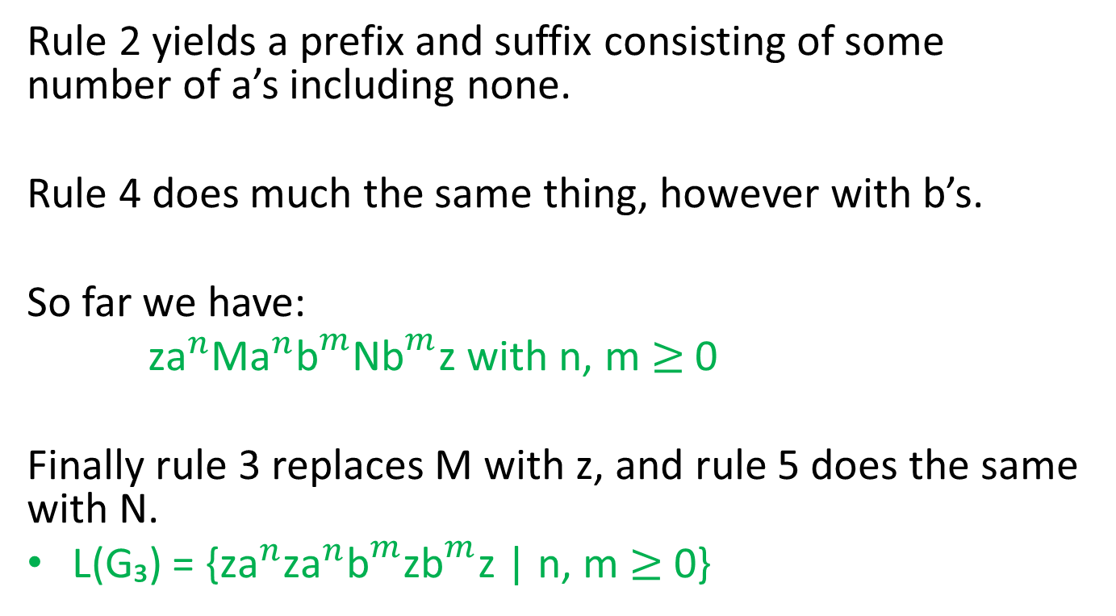
Context Free Languages
Notes:
Marked for Correction

Slide 11
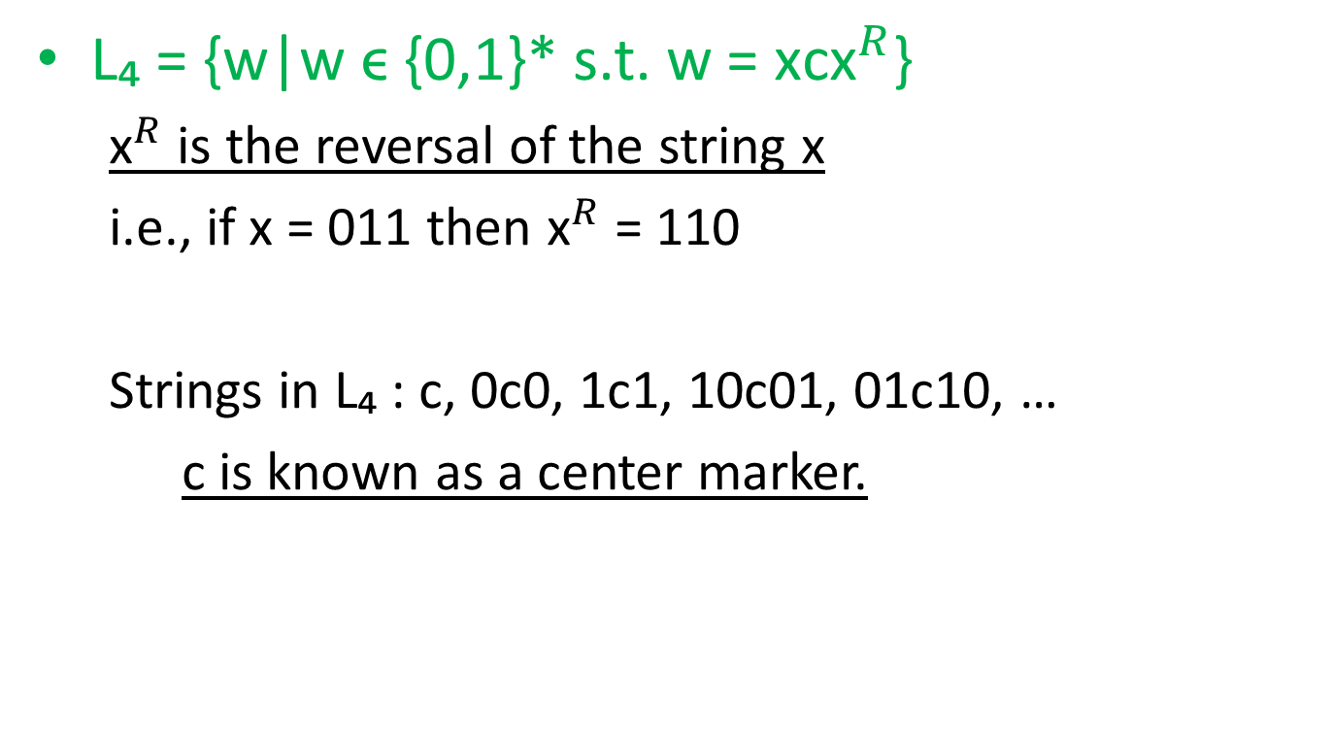
Context Free Languages
Notes:
Marked for Correction notation along with replace w with x!!!!

Slide 12
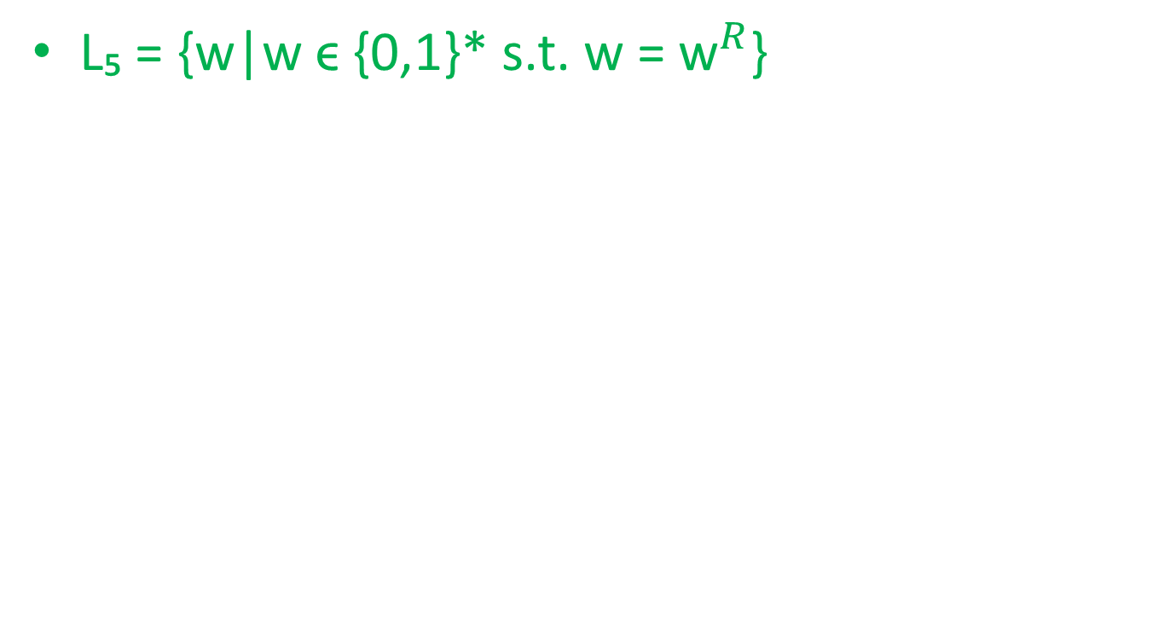
Context Free Languages

Slide 13
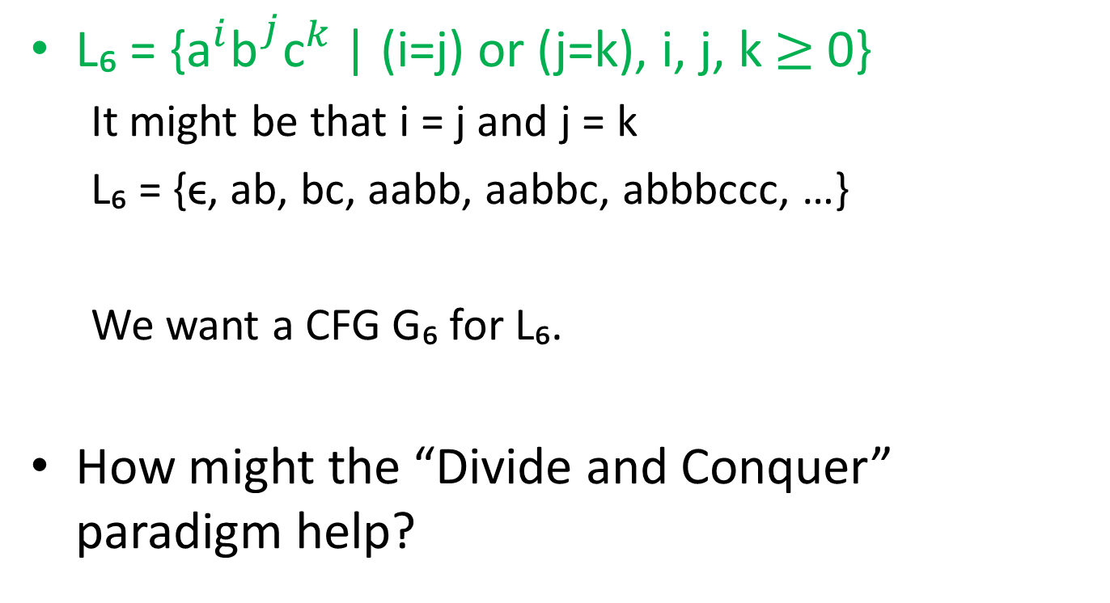
Context Free Languages

